Slide 1
중학생 과학게임:태양계의 모험
Game Play pattern을 활용한 Prompt Engineering

Slide 2
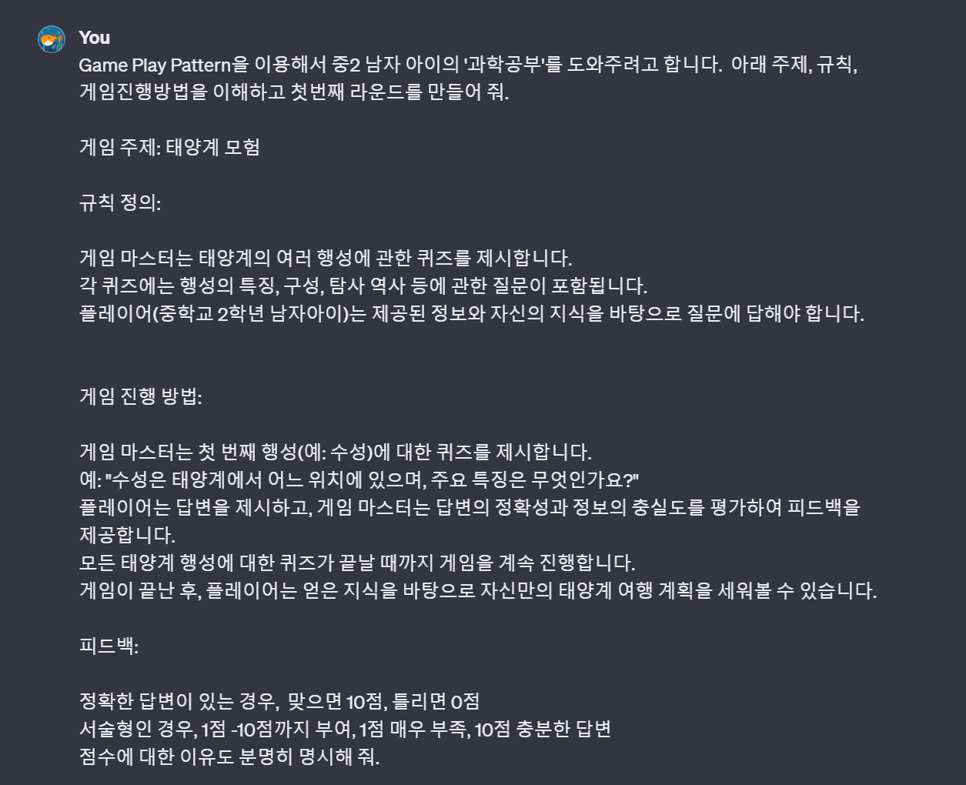
https://chat.openai.com/share/b0325913-f4cd-4f5b-9158-e783ebfb1c0d

Slide 3
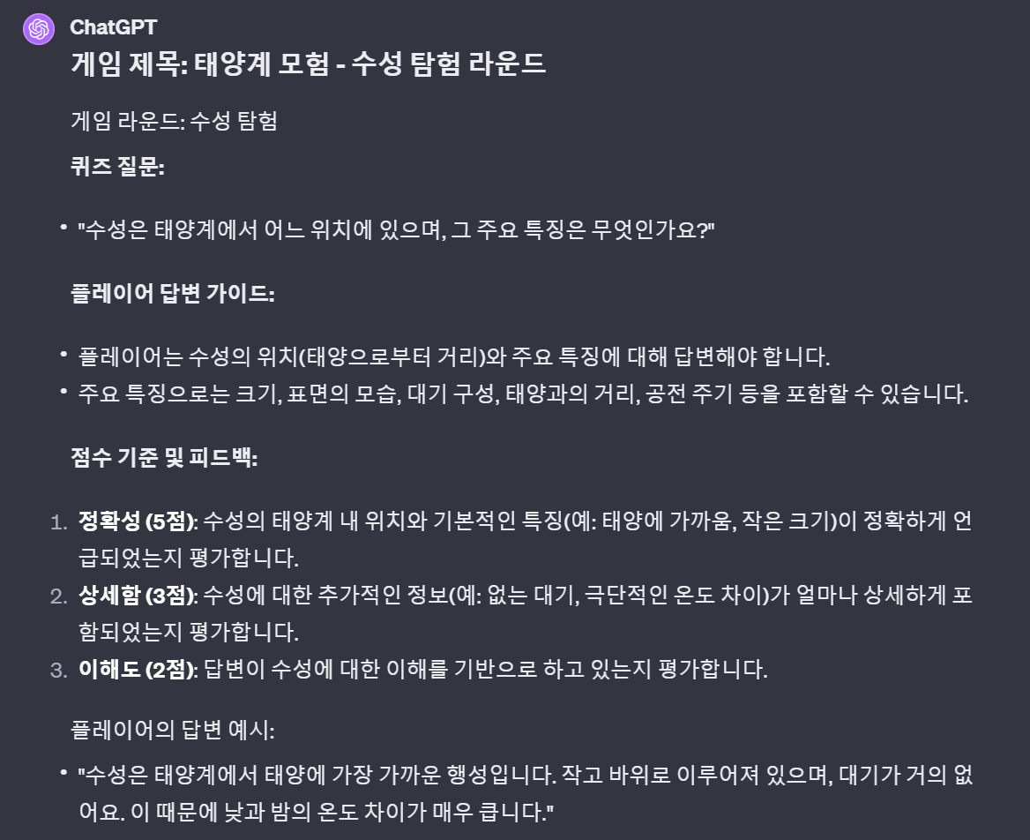
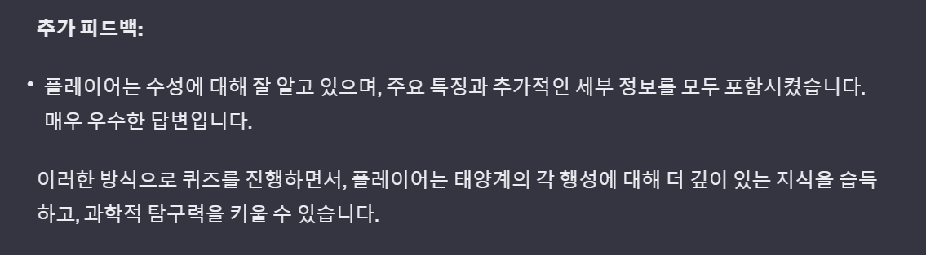
https://chat.openai.com/share/b0325913-f4cd-4f5b-9158-e783ebfb1c0d

Slide 4
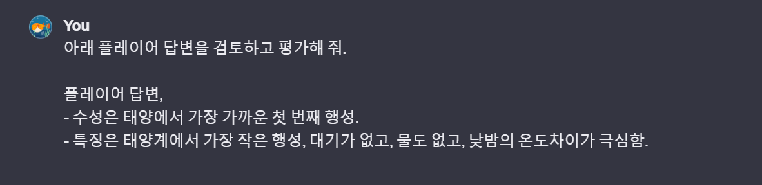
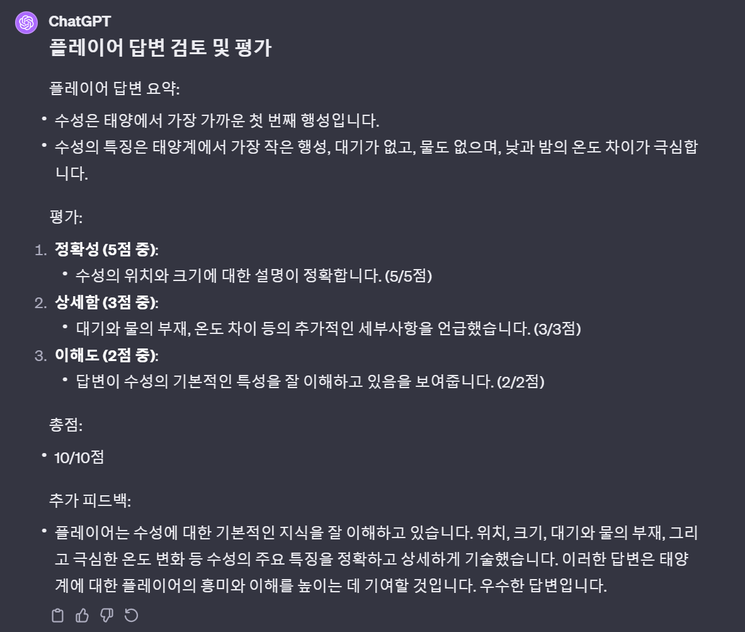
https://chat.openai.com/share/b0325913-f4cd-4f5b-9158-e783ebfb1c0d

